Slide 1
HUBzero Platform Features TRADES Proposal Demo Oct. 12, 2016 Derrick Kearney hubzero.org

Slide 2
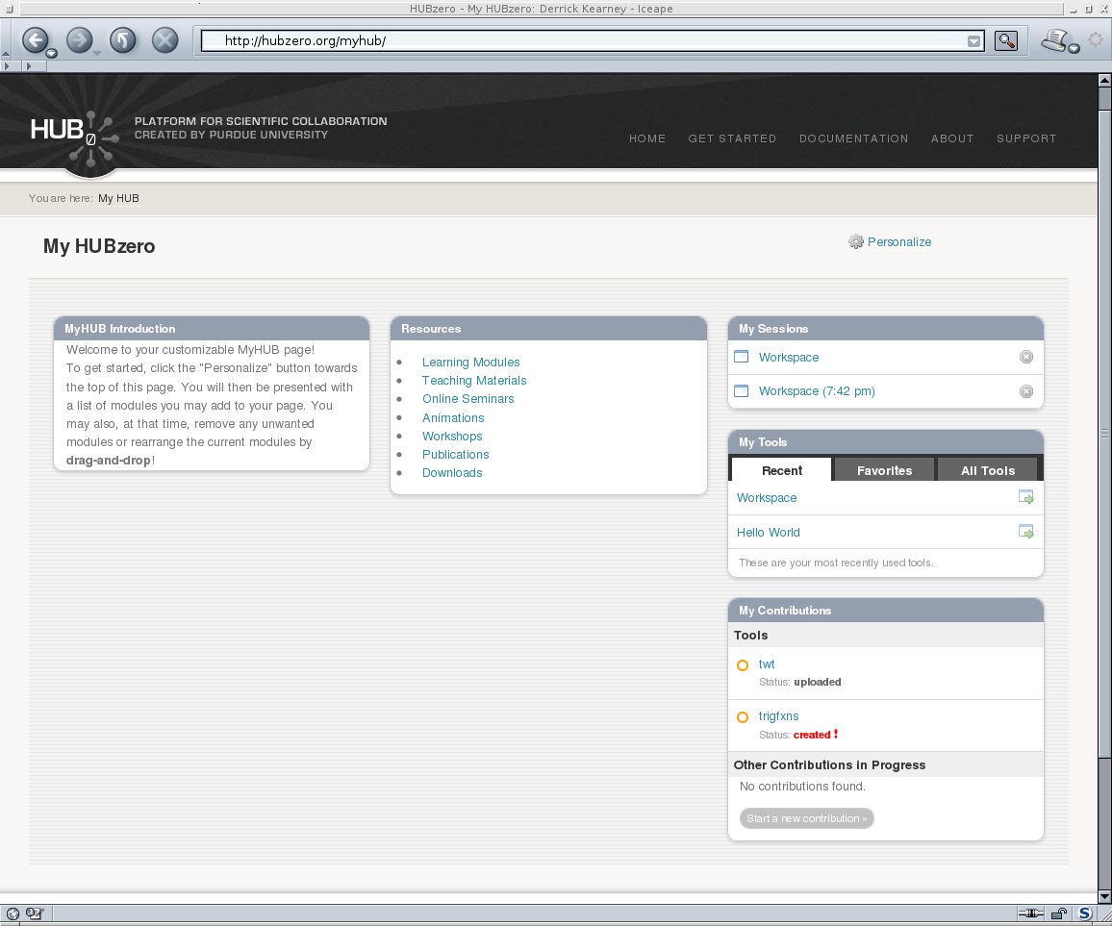
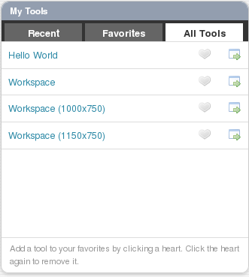
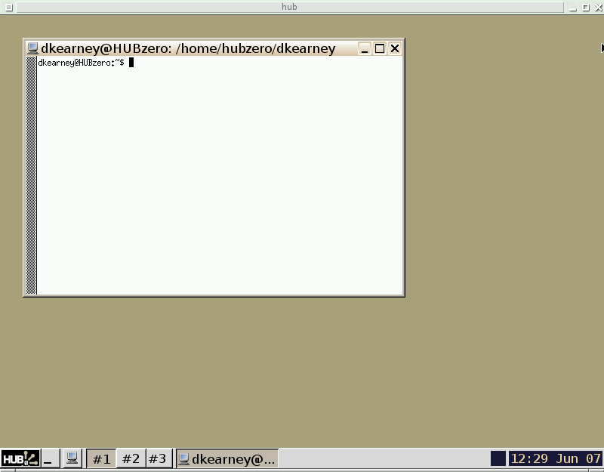
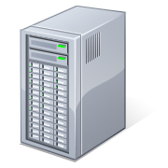
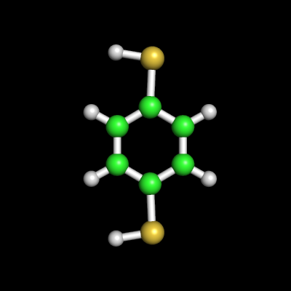
The HUBzero Platform
User's Web Browser
HUBzero Infrastructure
Web Server
Middleware
Grid
Submit
Proxy
Tool Session
Containers
Visualization

Slide 3
The HUBzero Platform

Slide 4
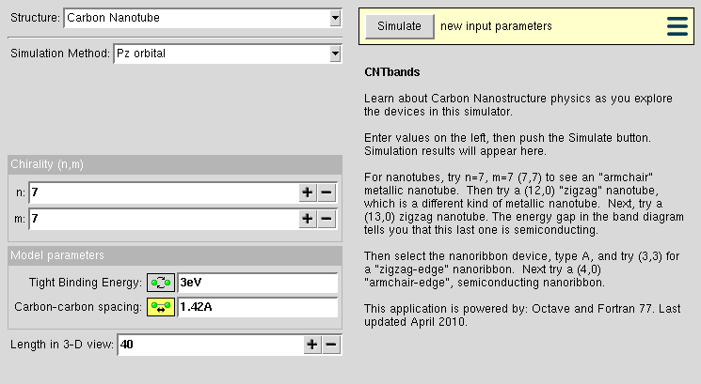
CNTbands
CNTbands
Science Domain: Nanoelectronics
Scientists: Lundstrom et al. (Purdue)
https://nanohub.org/resources/cntbands-ext

Slide 5
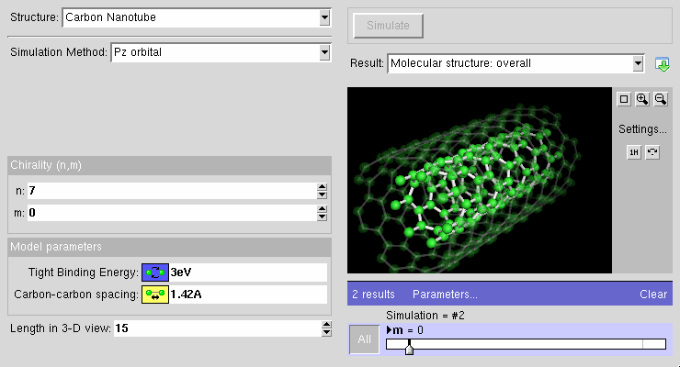
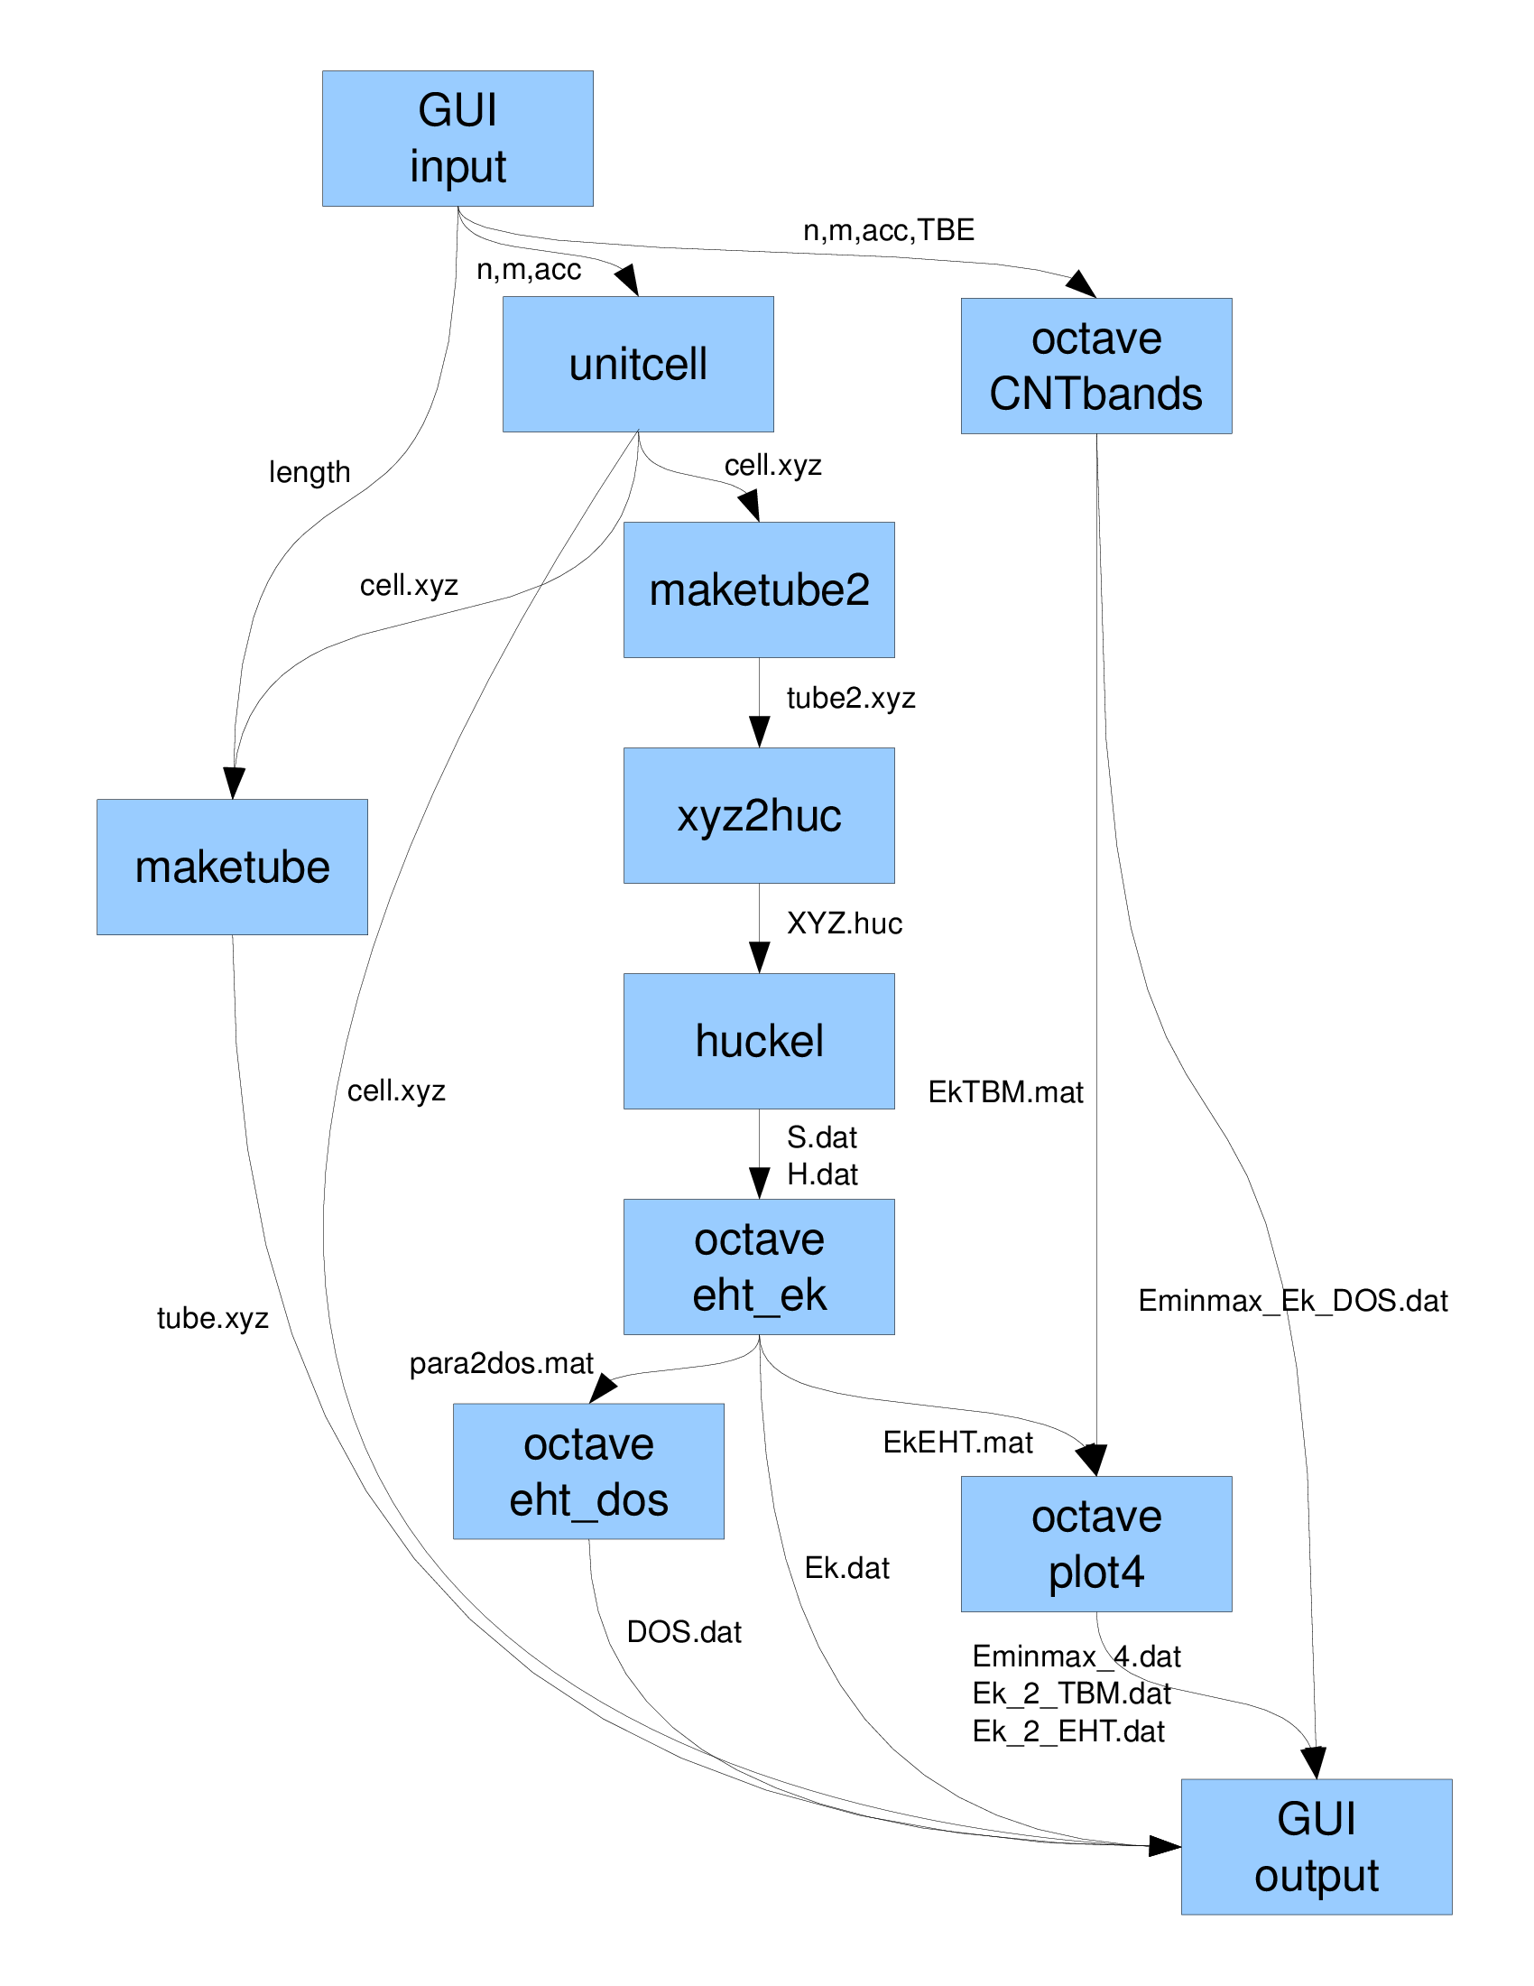
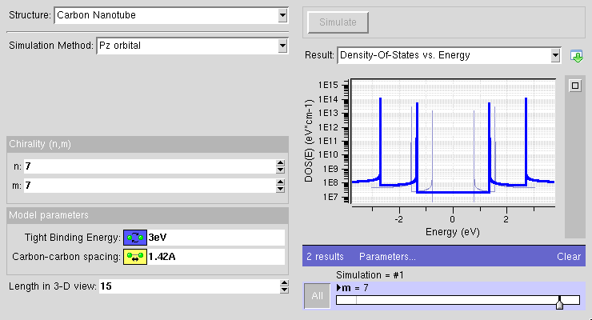
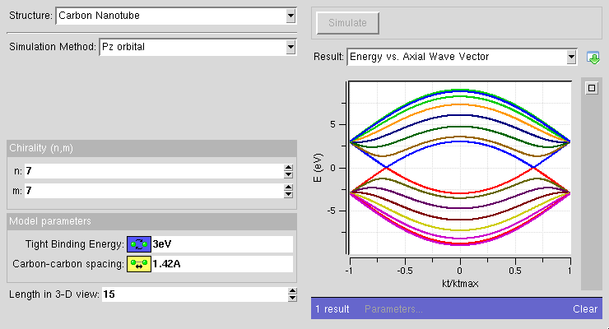
CNTbands
CNTbands
Science Domain: Nanoelectronics
Scientists: Lundstrom et al. (Purdue)
https://nanohub.org/resources/cntbands-ext

Slide 6
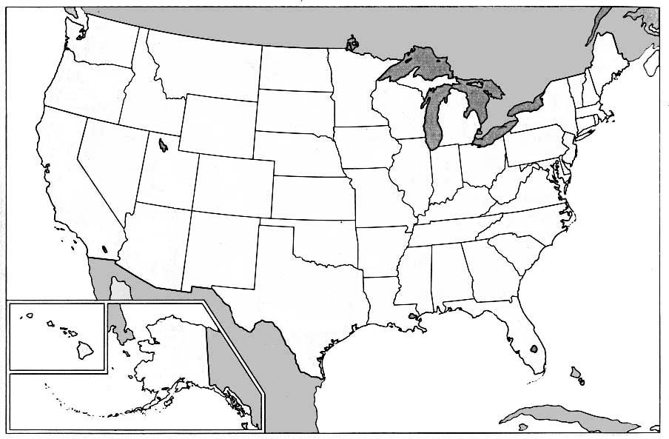
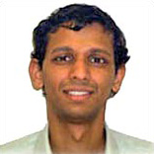

1990s – Initial Algorithms
M.P. Anantram
Researcher
NanoStructures

Slide 7
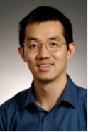
2002 – Idea for a Tool
M.P. Anantram
NASA Scientist
NanoStructures
Jing Guo
Researcher
Carbon Nanotubes

Slide 8
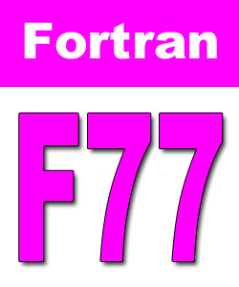

2002 – Tool Registered
Jing Guo
Researcher
Carbon Nanotubes
M.P. Anantram
NASA Scientist
NanoStructures

Slide 9
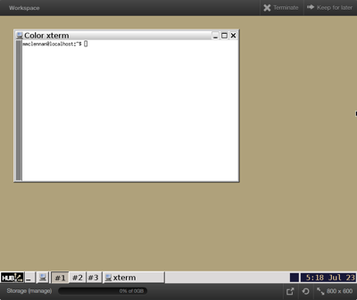
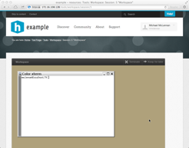

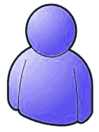


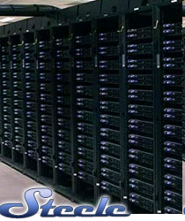

What is a Workspace?
Full-featured Linux or Windows Desktop
Runs in the Cloud
For tool developers & researchers
Accessible from any web browser
Still running after you close your browser
Access to computational clusters
File storage provided by the hub
local
clusters
File server
<number>

Slide 10
Collaboration / Groups

Slide 11
CNTbands
CNTbands
Science Domain: Nanoelectronics
Scientists: Lundstrom et al. (Purdue)
https://nanohub.org/resources/cntbands-ext

Slide 12
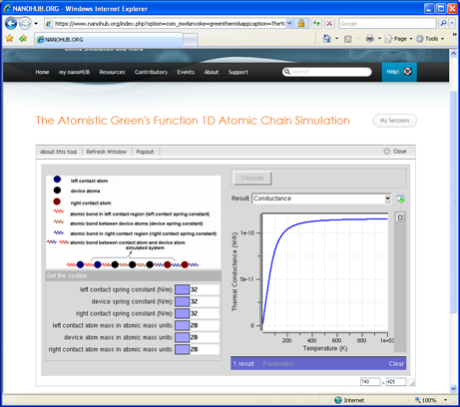
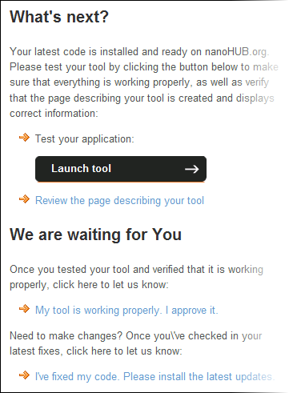
Installing Applications
waiting for…
User
Hub managers
Contribution form
Registered
Created
Uploaded
Installed
Updated
Approved
Published
Retired

Slide 13
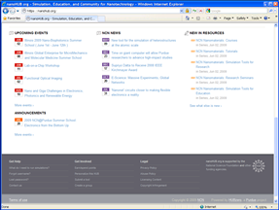
Publishing Applications
waiting for…
User
Hub managers
Contribution form
Registered
Created
Uploaded
Installed
Updated
Approved
Published
Retired

Slide 14
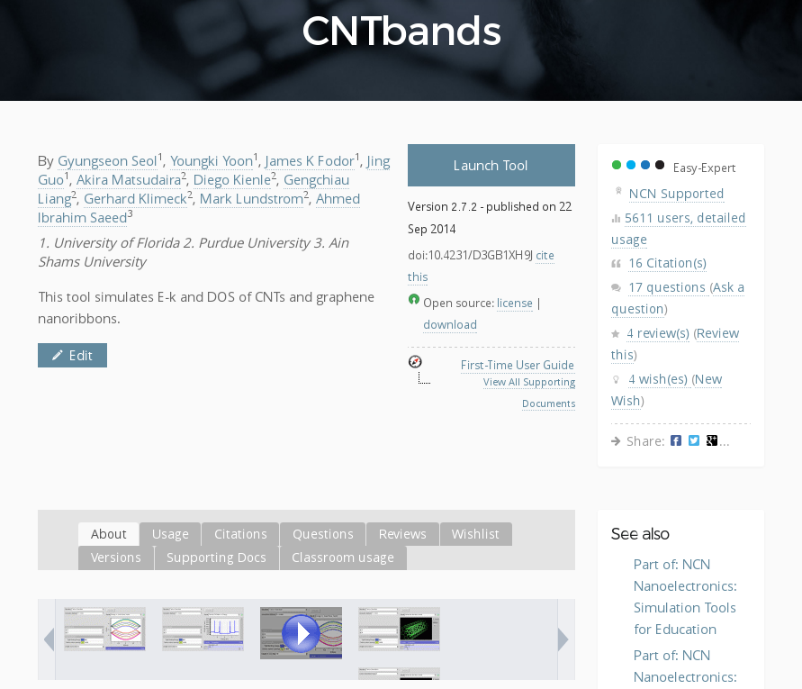
Knowing your impact

Slide 15
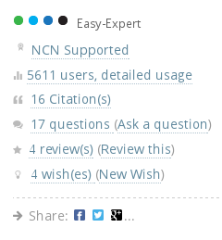
Communicate with users

Slide 16
Adding New Features
CNTbands
Science Domain: Nanoelectronics
Scientists: Lundstrom et al. (Purdue)
https://nanohub.org/resources/cntbands-ext

Slide 17
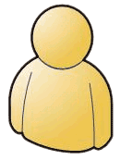
2010 – Introducing New Researchers
New Grad Student
Graphene
NanoRibbons
M.P. Anantram
Professor
NanoStructures
Jing Guo
Professor
Carbon Nanotubes

Slide 18
Collaborate in the Workspace
New Grad Student
Graphene
NanoRibbons
M.P. Anantram
Professor
NanoStructures
Jing Guo
Professor
Carbon Nanotubes

Slide 19
Collaborate in the Workspace
New Grad Student
Graphene
NanoRibbons
M.P. Anantram
Professor
NanoStructures
Jing Guo
Professor
Carbon Nanotubes

Slide 20
Collaborate in the Workspace
New Grad Student
Graphene
NanoRibbons
M.P. Anantram
Professor
NanoStructures
Jing Guo
Professor
Carbon Nanotubes

Slide 21
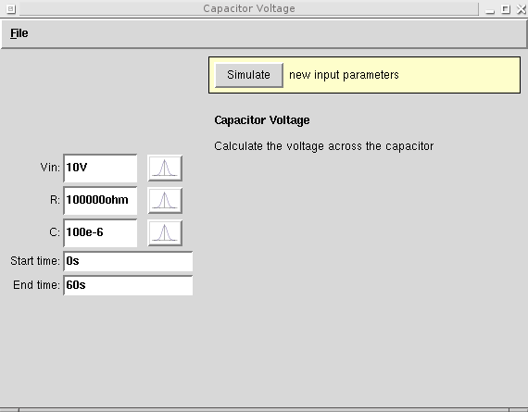

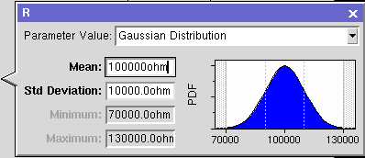
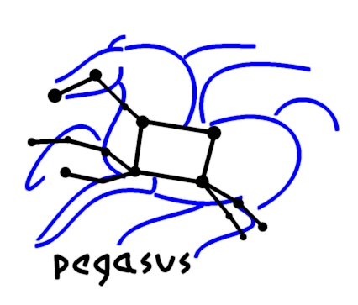
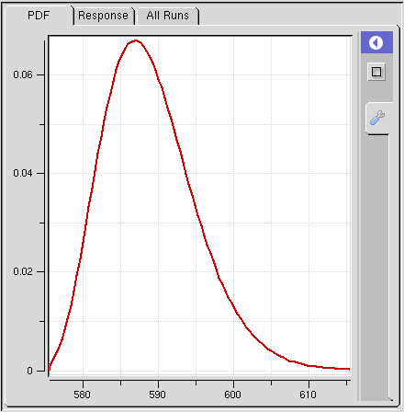
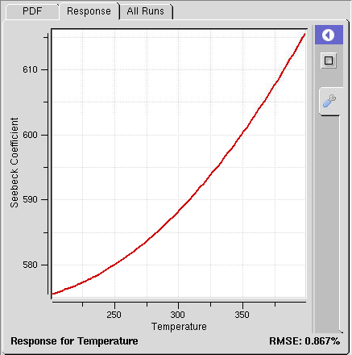
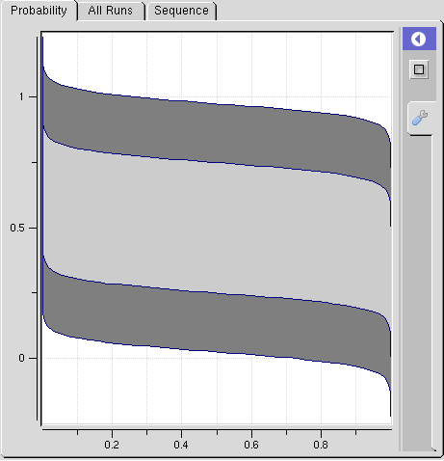
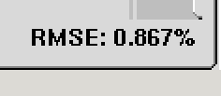
Productivity in the Workspace
Submit
Pegasus Workflows
Uncertainty Quantification
DAX
HUBzero Infrastructure
Tool Session
Containers
Submit
Proxy
Grid
Grid
Grid
Proxy
DAG
Grid
Grid
Grid
Grid
Notes:
While hubcheck library development has slowed over the last few months, there is still work to be done.
First, we need to continue to build more page objects to cover the web interface.
Need to put together a Debian package for easier installation of the software.
And we need to release the open source code in a hubzero repository connected to GitHub so others can use it.

Slide 22
Run tools locally in Workspace
User's Workspace Terminal
HUBzero Infrastructure
$ echo hi
hi
$
Tool Session
Containers
Submit
Proxy
Grid
Grid
Grid
Grid
Grid
Grid

Slide 23
Submit Jobs to Grid
User's Workspace Terminal
HUBzero Infrastructure
$ submit echo hi
Tool Session
Containers
Submit
Proxy
Grid
Grid
Grid
Grid
Grid
Grid

Slide 24
Let Submit create a workflow ...
User's Workspace Terminal
HUBzero Infrastructure
$ submit -p @@Vin=1-5 ./sim1.py --Vin @@Vin
scatter
Tool Session
Containers
Submit
Proxy
Vin=1
Vin=2
...
Vin=5
Grid
Grid
Grid
Grid
Grid
Grid
gather

Slide 25
… or write your own workflow
CNTBands
Science Domain: Nanoelectronics
Scientists: Lundstrom et al. (Purdue)
https://nanohub.org/resources/cntbands-ext

Slide 26
Productivity in the Workspace
Submit
Pegasus Workflows
Uncertainty Quantification
DAX
HUBzero Infrastructure
Tool Session
Containers
Submit
Proxy
Grid
Grid
Grid
Proxy
DAG
Grid
Grid
Grid
Grid
Notes:
While hubcheck library development has slowed over the last few months, there is still work to be done.
First, we need to continue to build more page objects to cover the web interface.
Need to put together a Debian package for easier installation of the software.
And we need to release the open source code in a hubzero repository connected to GitHub so others can use it.

Slide 27


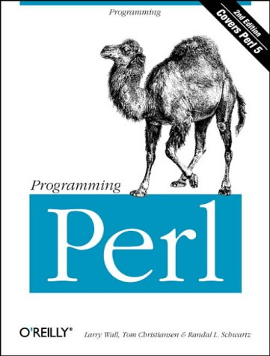
Pegasus Workflow Management
DAX
HUBzero Infrastructure
Developed at USC
Ewa Deelman et al.
Website: pegasus.isi.edu
Open Source
Bindings for your
favorite languages:
Tool Session
Containers
Submit
Proxy
Grid
Grid
Grid
DAG
Benefits:
Performance
Portability
Provenance
Data Management
Error Recovery
Grid
Grid

Slide 28
Productivity in the Workspace
Submit
Pegasus Workflows
Uncertainty Quantification
DAX
HUBzero Infrastructure
Tool Session
Containers
Submit
Proxy
Grid
Grid
Grid
Proxy
DAG
Grid
Grid
Grid
Grid
Notes:
While hubcheck library development has slowed over the last few months, there is still work to be done.
First, we need to continue to build more page objects to cover the web interface.
Need to put together a Debian package for easier installation of the software.
And we need to release the open source code in a hubzero repository connected to GitHub so others can use it.

